Slide 1
EC3357:Machine Learning
Lecture 3: Linear Regression

Slide 2
Supervised Learning – Linear Regression
The focus of supervised learning revolves around the input and output variables using an algorithm to predict the outcome, if a new input variable comes into the picture.
The linear regression algorithm in machine learning is a supervised learning technique to approximate the mapping function to get the best predictions.

Slide 3
What is Regression?
The main goal of regression is the construction of an efficient model to predict the dependent attributes from a bunch of attribute variables.
A regression problem is when the output variable is either real or a continuous value i.e salary, weight, area, etc.
It is used to predict the relationship between a dependent variable and a bunch of independent variables.

Slide 4
Definitions:
The variable that researchers are trying to explain or predict is called the response variable. It is also sometimes called the dependent variable because it depends on another variable.
The variable that is used to explain or predict the response variable is called the explanatory variable. It is also sometimes called the independent variable because it is independent of the other variable.
In regression, the order of the variables is very important.
The explanatory variable (or the independent variable) always belongs on the x-axis.
The response variable (or the dependent variable) always belongs on the y-axis.

Slide 5
Linear Regression – Simple example
Given one variable (X)
Goal: Predict Y
Example:
Given Years of Experience
Predict Salary
Questions:
When X=10, what is Y?
When X=25, what is Y?
This is known as regression
X (years) | Y (salary, $1,000)
3 | 30
8 | 57
9 | 64
13 | 72
3 | 36
6 | 43
11 | 59
21 | 90
1 | 20

Slide 6
Linear Regression Example

Slide 7
Basic Idea
Linear equation

Slide 8
For the example data
Thus, when x=10 years, prediction of y (salary)
is: 23.2+35=58.2 K dollars/year.

Slide 9
Example 2
Consider the example below where the mass, 𝑦 (grams), of a chemical is related to the time, 𝑥 (seconds), for which the chemical reaction has been taking place according to the table below.
Find the equation of the regression line.
Time, 𝑥 (seconds) | 55 | 77 | 1212 | 1616 | 2020
Mass, 𝑦 (grams) | 4040 | 120120 | 180180 | 210210 | 240

Slide 10
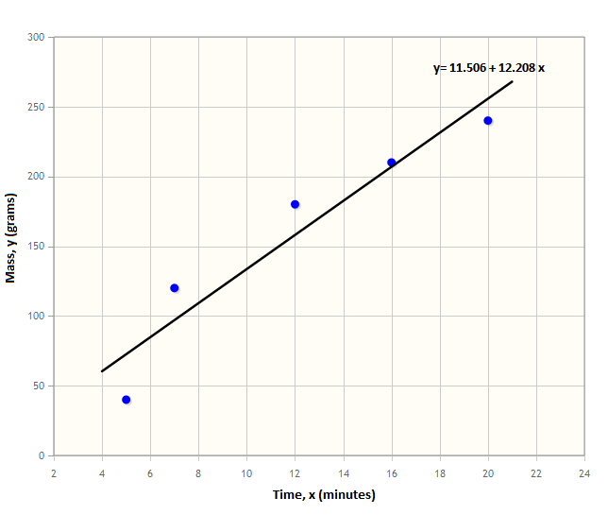
Example (Continued)

Slide 11
Interpreting the Regression Line
The simple linear regression line, 𝑦̂=𝑎+𝑏𝑥 , can be interpreted as follows:
x is the value of the independent variable
𝒚̂ (“y-hat”) is the predicted value of the response variable for a given value of x
b is the slope, the amount by which y changes for every one-unit increase in x
a is the intercept, the value of y when x = 0
We can also use the equation of the regression line for finding approximate values for missing data.

Slide 12
Linear Regression
Linear regression is a linear model, e.g. a model that assumes a linear relationship between the input variables (x) – independent variables and the single output variable (y) – dependent variable
More specifically, that y can be calculated from a linear combination of the input variables (x).
When there is a single input variable (x), the method is referred to as simple linear regression.
When there are multiple input variables, literature from statistics often refers to the method as multiple linear regression

Slide 13
Simple Linear Regression
One of the most interesting and common regression technique is simple linear regression.
In this, we predict the outcome of a dependent variable based on the independent variables, the relationship between the variables is linear. Hence, the word linear regression.
Simple linear regression is a regression technique in which the independent variable has a linear relationship with the dependent variable. The straight line in the diagram is the best fit line.
The main goal of the simple linear regression is to consider the given data points and plot the best fit line to fit the model in the best way possible.

Slide 14
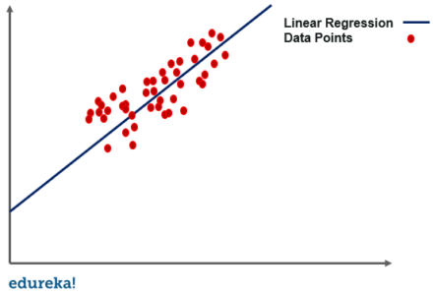
Simple Linear Regression

Slide 15
Simple Linear Regression
Simple regression problem (a single x and a single y), the form of the model would be:
b0 (y-intercept) and b1 (slope) are the coefficients whose values represent the accuracy of predicted values with the actual values.
Constant
Coefficient
y = b0 + b1 * x1
Dependent variable (DV)
Independent variable (IV)

Slide 16
Example-2
Let’s make this concrete with another example. Imagine we are predicting weight (y) from height (x). Our linear regression model representation for this problem would be:
y = B0 + B1 * x1
or
weight =B0 +B1 * height

Slide 17
Where B0 is the bias coefficient and B1 is the coefficient for the height column. We use a learning technique to find a good set of coefficient values. Once found, we can plug in different height values to predict the weight.
For example, lets use B0 = 0.1 and B1 = 0.5. Let’s plug them in and calculate the weight (in kilograms) for a person with the height of 182 centimeters.
weight = 0.1 + 0.05 * 182
weight = 91.1
You can see that the above equation could be plotted as a line in two-dimensions. The B0 is our starting point regardless of what height we have.
We can run through a bunch of heights from 100 to 250 centimeters and plug them to the equation and get weight values, creating our line.

Slide 18
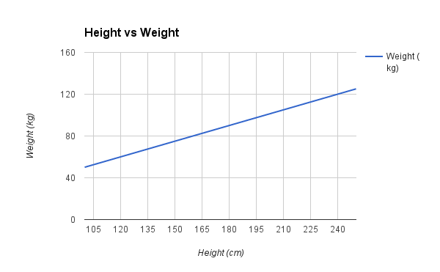

Slide 19
Simple Linear Regression-Let’s code
Step 1: Import the required python packages
Step 2: Load the dataset
Step 3: Data analysis
Step 4: Split data into Train/Test sets
Step 5: Train the regression model
Step 6: Predict the result

Slide 20
Example
https://medium.com/@shuv.sdr/simple-linear-regression-in-python-a0069b325bf8

Slide 21
Implement Simple Linear Regression in Python
In this example, we will use the salary data concerning the experience of employees. In this dataset, we have two columns YearsExperience and Salary

Slide 22
Step 1: Import the required python packages
We need Pandas for data manipulation, NumPy for mathematical calculations, and MatplotLib, and Seaborn for visualizations. Sklearn libraries are used for machine learning operations.
# Import libraries
import pandas as pd
import numpy as np
import matplotlib.pyplot as plt
import seaborn as sns
from sklearn.model_selection import train_test_split
from pandas.core.common import random_state
from sklearn.linear_model import LinearRegression

Slide 23
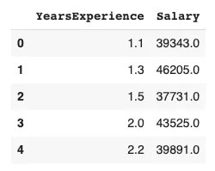
Step 2: Load the dataset
Download the dataset and upload it to your notebook and read it into the pandas dataframe.
# Get dataset
df_sal = pd.read_csv('/content/Salary_Data.csv’)
df_sal.head()

Slide 24
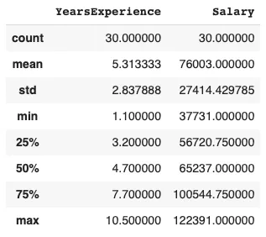
Step 3: Data analysis
Now that we have our data ready, let's analyze and understand its trend in detail. To do that we can first describe the data below –
# Describe data
df_sal.describe()
Here, we can see Salary ranges from 37731 to 122391 and a median of 65237.

Slide 25
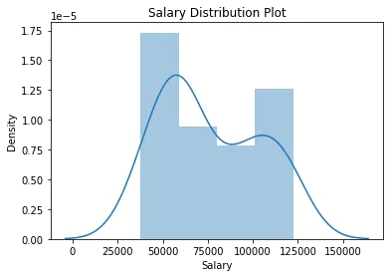
We can also find how the data is distributed visually using Seaborn distplot.
# Data distribution plt.title('Salary Distribution Plot') sns.distplot(df_sal['Salary']) plt.show()
A distplot or distribution plot shows the variation in the data distribution.
It represents the data by combining a line with a histogram.

Slide 26
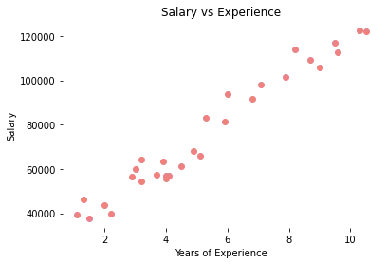
Check the relationship between Salary and Experience -
# Relationship between Salary and Experience plt.scatter(df_sal['YearsExperience'], df_sal['Salary'], color = 'lightcoral') plt.title('Salary vs Experience') plt.xlabel('Years of Experience') plt.ylabel('Salary') plt.box(False) plt.show()
It is clearly visible now, our data varies linearly. That means, that an individual receives more Salary as they gain Experience.

Slide 27
Step 4: Split the dataset into dependent/independent variables
Experience (X) is the independent variable. Salary (y) is dependent on experience.
# Splitting variables X = df_sal.iloc[:, :1] # independent y = df_sal.iloc[:, 1:] # dependent

Slide 28
Step 4: Split data into Train/Test sets
Further, split your data into training (80%) and test (20%) sets using train_test_split
# Splitting dataset into test/train X_train, X_test, y_train, y_test = train_test_split(X, y, test_size = 0.2,random_state = 0)

Slide 29
Step 5: Train the regression model
Pass the X_train and y_train data into the regressor model by regressor.fit to train the model with our training data.
# Regressor model regressor = LinearRegression() regressor.fit(X_train, y_train)

Slide 30
Step 6: Predict the result
Here comes the interesting part, when we are all set and ready to predict any value of y (Salary) dependent on X (Experience) with the trained model using regressor.predict
# Prediction result y_pred_test = regressor.predict(X_test) # predicted value of y_test y_pred_train = regressor.predict(X_train) # predicted value of y_train

Slide 31
Step 7: Plot the training and test results
Its time to test our predicted results by plotting graphs.
Plot training set data vs predictions
First we plot the result of training sets (X_train, y_train) with X_train and predicted value of y_train (regressor.predict(X_train))
# Prediction on training set plt.scatter(X_train, y_train, color = 'lightcoral') plt.plot(X_train, y_pred_train, color = 'firebrick') plt.title('Salary vs Experience (Training Set)') plt.xlabel('Years of Experience') plt.ylabel('Salary') plt.legend(['X_train/Pred(y_test)', 'X_train/y_train'], title = 'Sal/Exp', loc='best', facecolor='white') plt.box(False) plt.show()

Slide 32
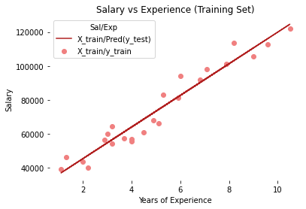

Slide 33
Plot test set data vs predictions
Secondly, we plot the result of test sets (X_test, y_test) with X_train and predicted value of y_train (regressor.predict(X_train))
# Prediction on test set plt.scatter(X_test, y_test, color = 'lightcoral') plt.plot(X_train, y_pred_train, color = 'firebrick') plt.title('Salary vs Experience (Test Set)') plt.xlabel('Years of Experience') plt.ylabel('Salary') plt.legend(['X_train/Pred(y_test)', 'X_train/y_train'], title = 'Sal/Exp', loc='best', facecolor='white') plt.box(False) plt.show()

Slide 34
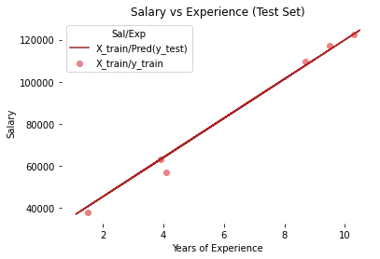
We can see, in both plots, the regressor line covers train and test data.

Slide 35
If you remember from the beginning of this topic, we discussed the linear equation 𝑦̂=𝑎+𝑏𝑥, we can also get the a (y-intercept) and a (slope/coefficient) from the regressor model.
# Regressor coefficients and intercept print(f'Coefficient: {regressor.coef_}') print(f'Intercept: {regressor.intercept_}’)

